Slide 1

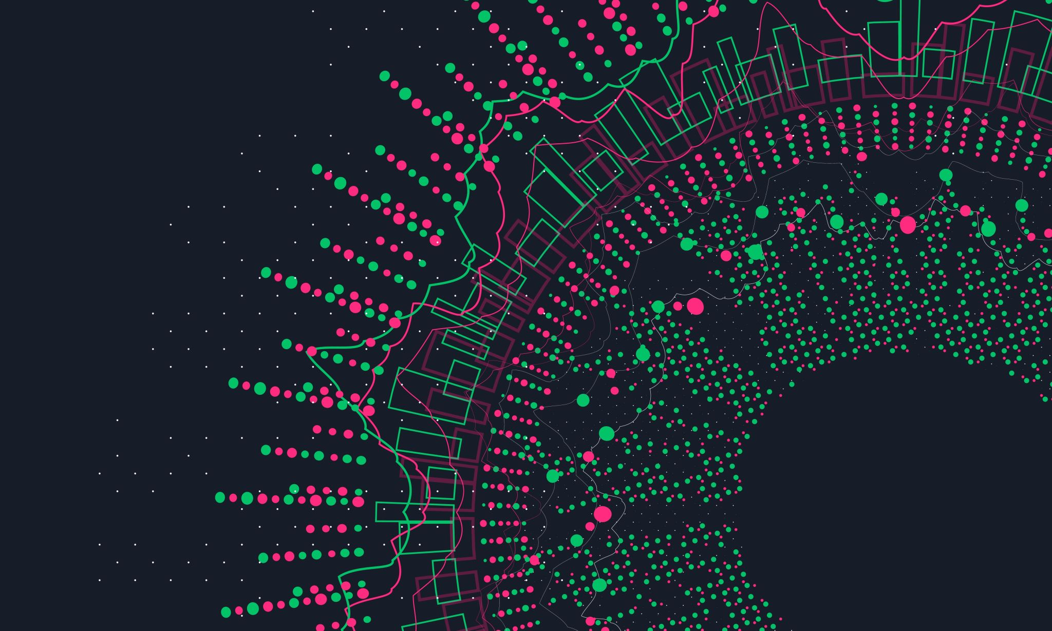
The Python Language
By: Michael Zelaya

Slide 2

History
Guido van Rossum
Create programs quickly but also make it easy to modify.
Easy to learn than other popular languages.
Python is interpreted, making developing and testing short programs easier.
Reads your program and executes it.

Slide 3
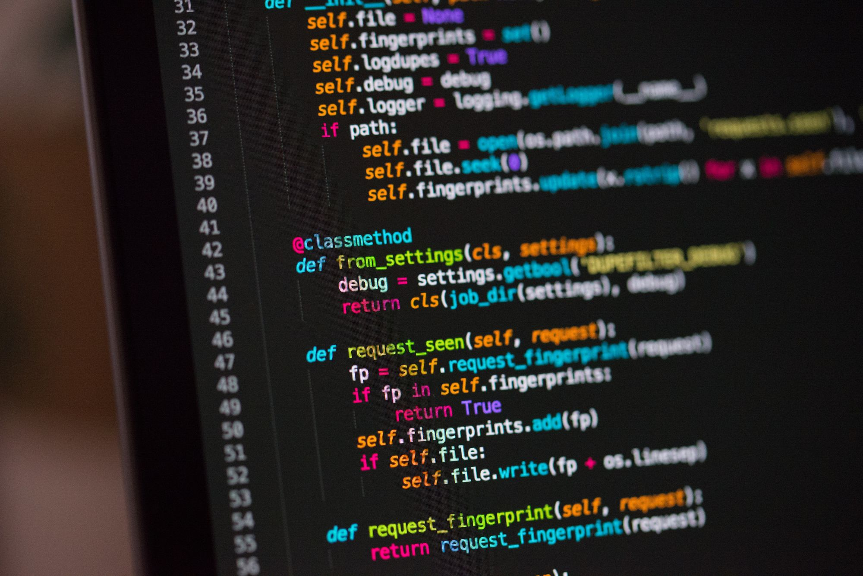
Features
Free and Open Source
Easy to learn (code and read)
Object-Oriented Language:
Class, objects, inheritance, etc.
Easy to Debug:
Python’s error code
Portable language:
It can run the same code on any platform like Mac, Windows, etc.
Large Standard Library:
Matplotlib, Pandas, Numpy, etc.

Slide 4
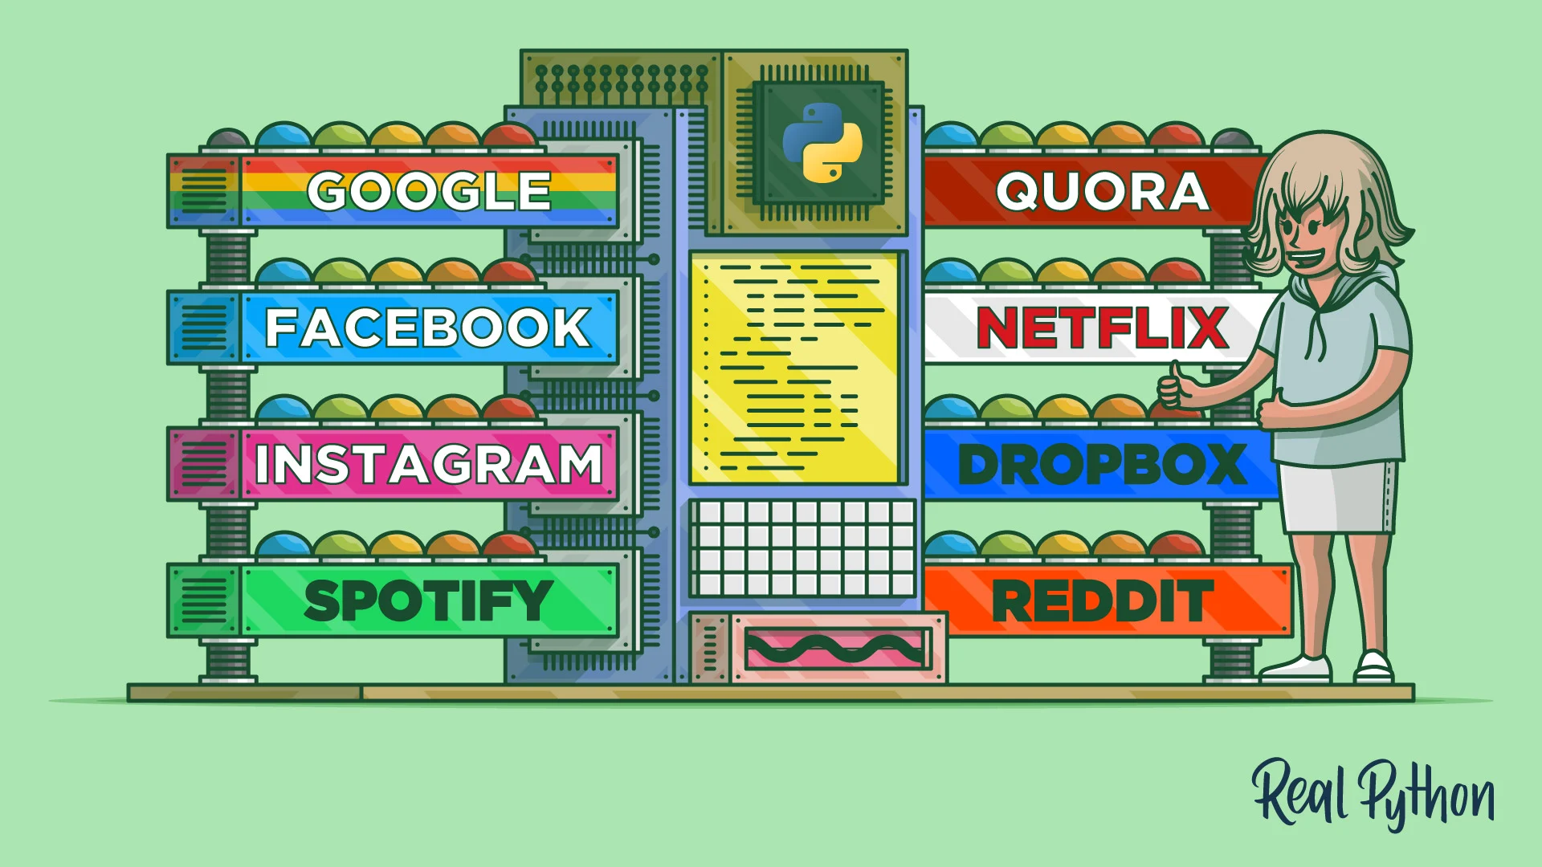
Application
Web and Internet Development:
Amazing visualization, convenience, enhanced security, and fast development process.
Scientific and Numeric computing:
Pandas- data analysis and modeling library
Data Science:
Built-in libraries provide fine-tuning data models, data preprocessing, and performing data analysis.
Software Development:
Google, Netflix, and Reddit all use Python.
Web Scraping Application:
Extract information from websites in an easier and faster way.

Slide 5
Work Cited
https://www.geeksforgeeks.org/python-features/
https://www.python.org/about/apps/
https://www.geeksforgeeks.org/top-10-python-applications-in-real-world/

